Slide 1
Assignment 5
Lo-Fi Prototypes
Asa K, Max V, Marco P

Slide 2
Overview
Selecting an Interface
Testing Interface
Making Changes to Interface

Slide 3
Connectr
Making public transit easier through connection

Slide 4
Chat
Widget
Pro
Con
Pro
Con
Can answer any question
Similar to messaging apps
Easy to interact with
Could be too open ended
Have to type every question
Bite sized information
No typing
Limited inputs
Boring input
No interaction with other people

Slide 5
Selected Interface & Rationale
Chat Based Design
(Mobile)
Easy to understand
Open ended
Familiar format
Need real time location information
“On the go” solution

Slide 6
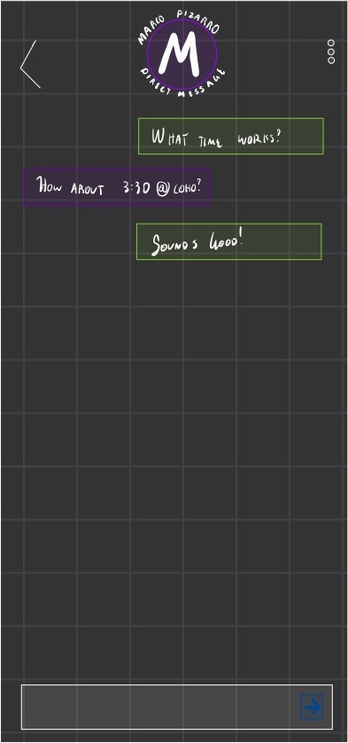
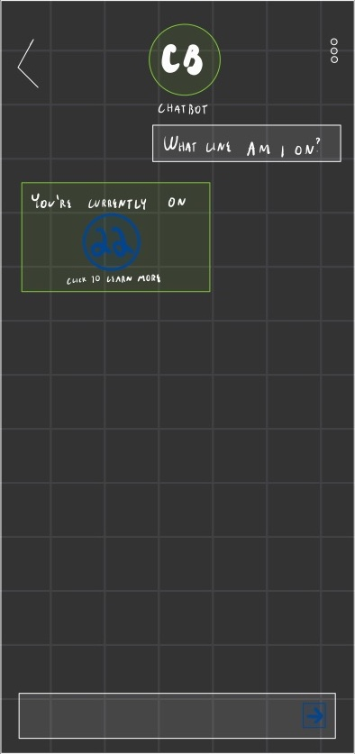
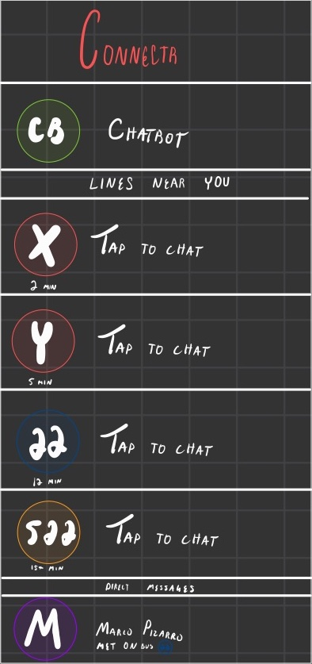
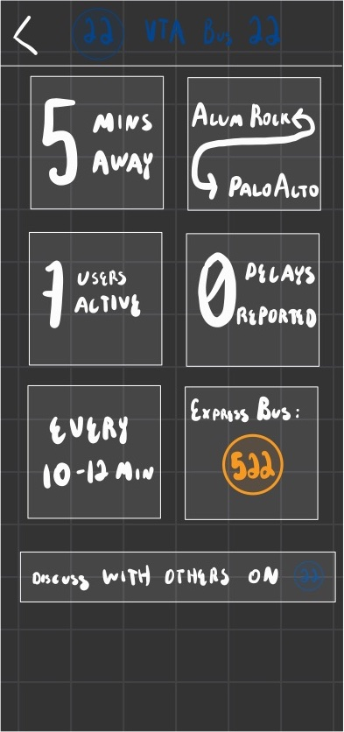
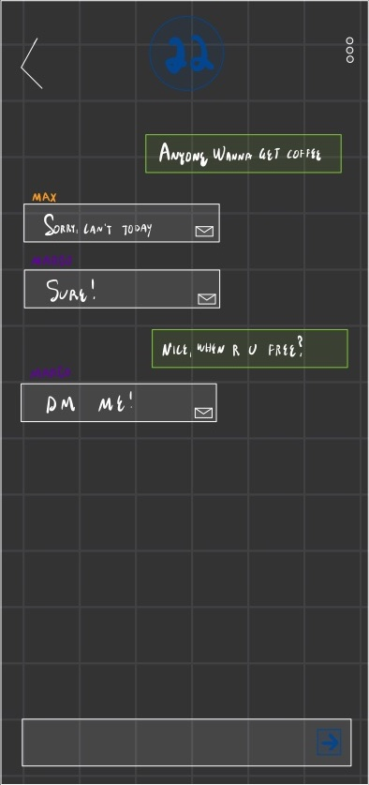
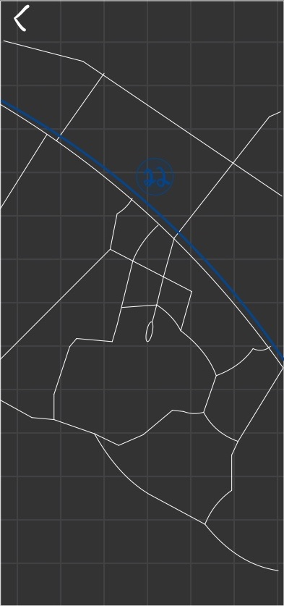
Prototype Structure

Slide 7
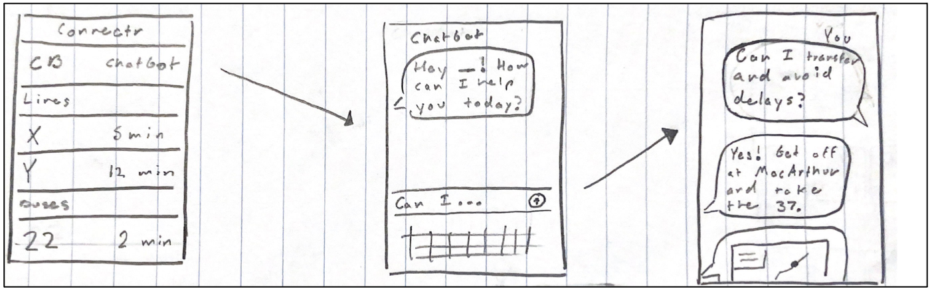
Task Flows – ChatBot

Slide 8
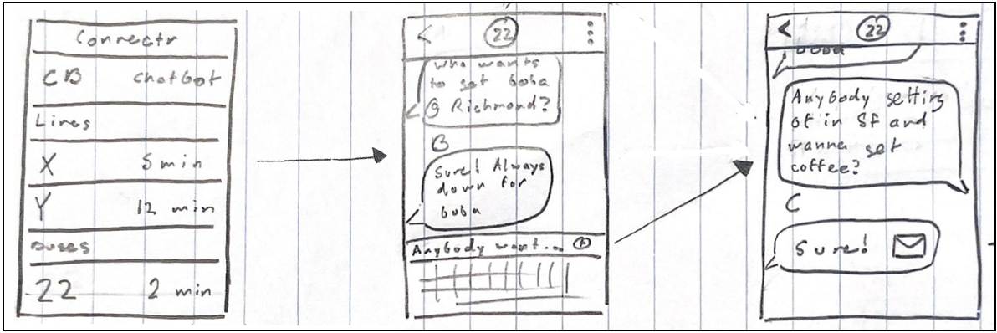
Task Flows – Chat w/ Others

Slide 9
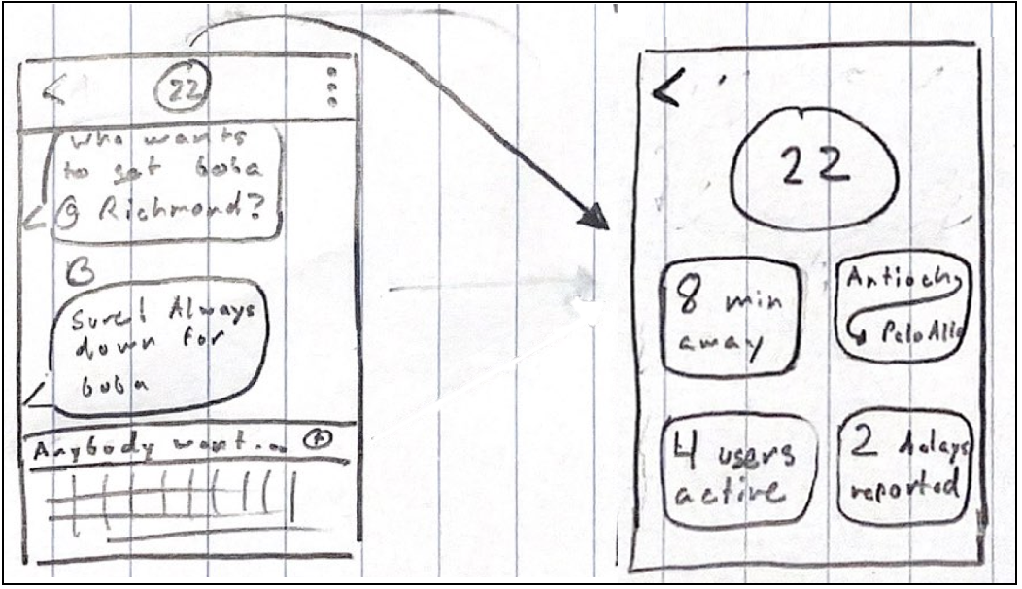
Task Flows – Info About Bus

Slide 10
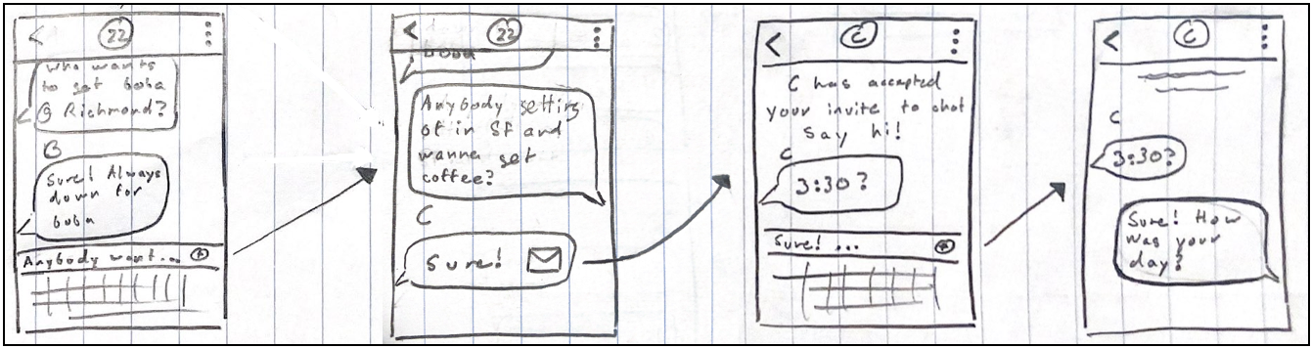
Task Flows – Direct Message

Slide 11



Experimental Method
We recruited participants over NextDoor
All Frequent Public Transit Users
Stephanie
26, Nanny, recently moved from Singapore
Leah
42, lifelong Bay Area Resident
Deborah
58, Grandmother

Slide 12
Experimental Method
Conducted over Zoom
Users shared screen
Shared InVision link with users to use on their phones
Prompted users with common situations they might find themselves in on public transit
Test measures:
Useful
Easy to Navigate/Understand
Greeter:Asa/ Marco
Facilitator: Max
Notetaker: Asa/Marco

Slide 13
Experimental Results - Chatbot
“This is immediately confusing to me. There’s no button that says, ‘what line am I on?’. I see this and I freeze.”
“Chatbot starts everything?”
“It’s natural to you but it’s not natural to me.”
“the questions are almost always the same.”
“This is really useful to me! I recognize the lines from my daily commute!”

Slide 14
Experimental Results - Chat w/ Others
“that's really cool!”
“It’s like in the movies for sure”
Like that the app knows where they are
“New systems can be really hard to use Google Maps doesn’t have as much information as community members. I would prefer to ask people who know the area.”

Slide 15
Experimental Results - Info About Bus
“Oh cool, it tells you how many people are on!”
Hardest task for people to figure out
“I like that it tells you how far away the bus is, that’s always something I want to know.”

Slide 16
Experimental Results - Direct Message
Speculating similar relationship between iMessage/WhatsApp/ common messaging apps on phone
“The envelope, easy!”
Fastest Task for most people
Want a level of anonymity in DMs

Slide 17
Suggested UI Changes
“the questions are almost always the same.”
Adding pre-populated questions to chatbot screen to allow users to select one easily
Want access to information without typing
Add useful bite-sized information to main screen
People could not find “more info screen”
Add text to messaging screen indicating you can find more information
Want anonymity while on platform
Only show first name of users

Slide 18
Summary
Generally positive feedback on app
Like familiarity of chatting
Symbols work well
Some issues with usability
People excited about chat features and community engagement

